Slide 1
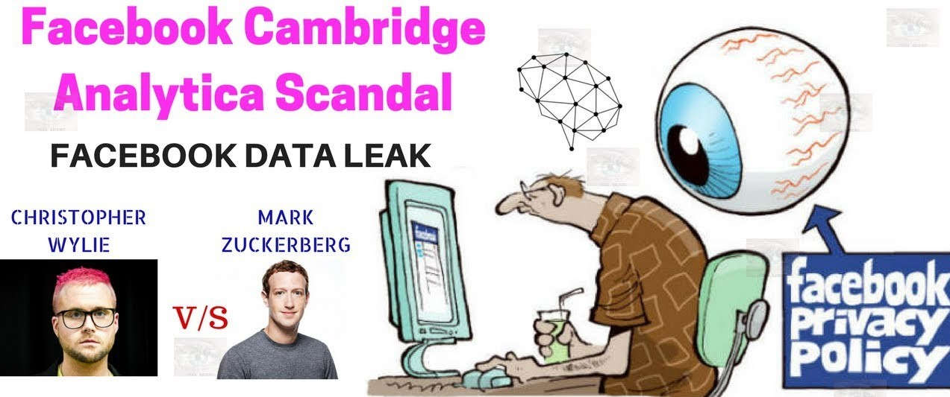
DATA PRIVACY AND PROTECTION
Presented by:
Vimal Jaswal - B00122875
Priyanka Aggarwal – B00123045
Masters of Engineering in Internet of things technologies
TU Dublin, Blanchardstown, Ireland.

Slide 2
Facebook / Cambridge Analytica Scandal
Cambridge Analytica - a British consulting firm specialized for marketing and political campaigns. Tagline - “data drives all we do”
2018 - It was revealed that Cambridge Analytica had collected and used personal data of millions of Facebook profiles without their consent for political purposes.
Aleksandr Kogan, Russian-American psychology professor, developed an app called –’This Is Your Digital Life’ for Cambridge Analytica. Cambridge Analytica arranged a personality survey in which millions Facebook users participated. This app retrieved personal information of Facebook users and their friends.
The Observer and New York Times reported that dataset had 50 million Facebook users records. But actually had 87 million users records as per Facebook.
Different political organizations have used data breach information to try to influence public opinion.
Political Campaigns of Donald Trump and Ted Cruz (United States 2015,2016).
Brexit vote (2016).
Mexican general election (Institutional Revolutionary Party 2018).
A turning point in public understanding of personal data has caused a massive drop in the stock price of Facebook and calls for tighter regulation of the use of data by tech companies.

Slide 3
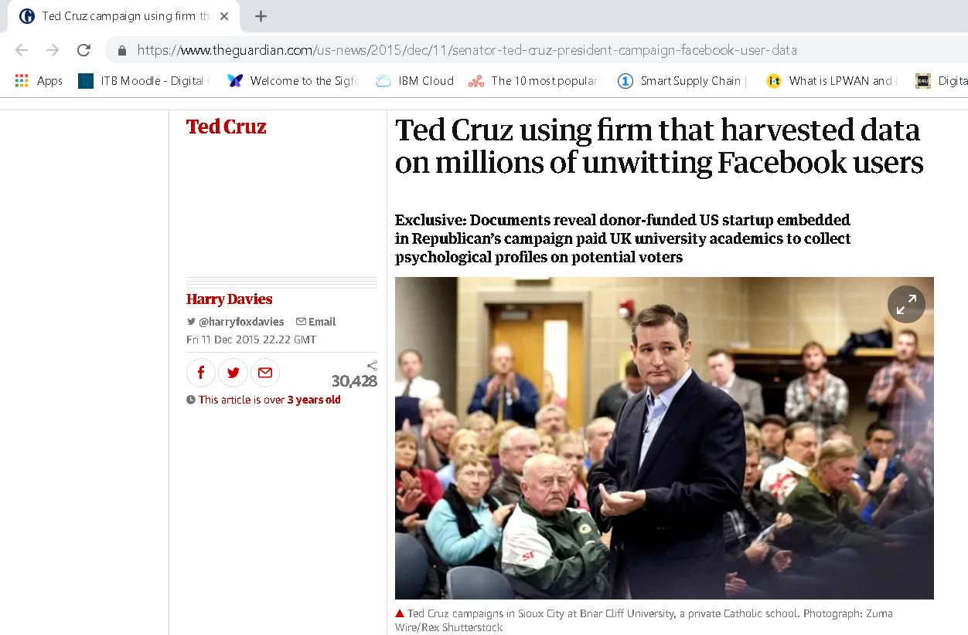
Background of Facebook / Cambridge Analytica case
Harry Davies reported that Cambridge Analytica worked for Ted Cruz and used data from millions of Facebook accounts collected without their consent. Facebook declined the story except to say that it was investigating. (The Guardian Dec. 2015)

Slide 4
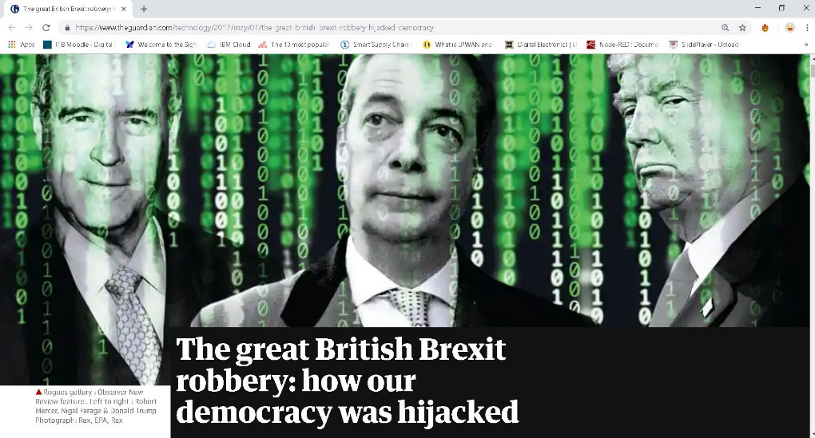
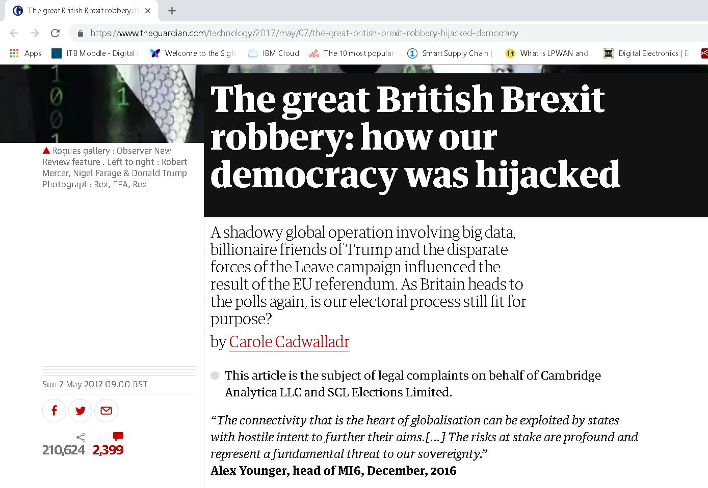
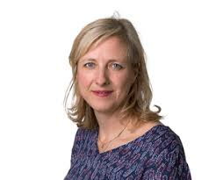
Background of Facebook / Cambridge Analytica case
Further reports and articles were published in The Guardian, The Intercept and followed in the Swiss publication Das Magazin. Facebook declined all of the articles claims.
In March 2018, the scandal unfolded by Christopher Wylie, an ex-employee of Cambridge Analytica. In 2017, he was an anonymous source for an article ’The Great British Brexit Robbery’ in The Observer by Cadwalladr. This article was viral, but it was disbelieved in some states.
Cadwalladr later published Channel 4 News in the UK and The New York Times because of threats.

Slide 5
Background of Facebook / Cambridge Analytica case
Simultaneously, the three news organizations published on March 17, 2018 and caused a huge outcry from the public.
More than $ 100 billion has been knocked off the share price of Facebook in days and politicians in the United States and the United Kingdom have asked Facebook CEO Mark Zuckerberg for answers. The scandal eventually led him to testify before the U.S. Congress.
The scandal provoked public debate on ethical standards for politicians, political consulting companies and social media organizations.
Consumer advocates demanded greater privacy and protection rights of users in online media and restrictions on misinformation.

Slide 6
GDPR - Data Privacy and Protection Issues
Collaboration: (The digital media and the Internet industry) Users provide their personal data for using service which is then used for advertising and marketing for revenues. (Facebook, Amazon, Uber etc.)
Intermediaries: Users, Facebook(Social Network) and Third Parties.
- Why did the Facebook allow friends data to be automatically collected?
- How potential data breaches can be addressed?
- Who is responsible if the terms between Facebook and third parties have been violated?
Data violations, data misuse and user rights violations are inherently linked.
Content Issue: There are legal and ethical issues concerning the collection of type of personal data, its use and data analysis.
User Awareness and protection Issue: Issue of awareness of the terms and conditions and implications of consent and users data rights protection. Generally, the data is given by the users in exchange for a good or service.
Economic Issue: Compensating users in case of data violation or revenue generation. Challenges of taxing the digital economy.
Data Privacy and Security Issue: Kogan found a loophole in the Facebook API that enabled to collect information of users and their all Facebook friends which raised security concerns.

Slide 7
Dealing with Data Privacy and Protection Issues
Facebook Claims:
In December 2015, They immediately banned Kogan's app from their platform and demanded certifications that they had deleted all improperly acquired data.
In a blog post on April 4, 2018, Facebook announced a series of changes to data handling practices and API access capabilities.
On May 14, 2018, "around 200" apps were banned from Facebook as part of an investigation into if companies have abused APIs to harvest personal information.
In June 2018, Facebook discontinued the trending feature.
In a July 2018 interview with Recode, Zuckerberg stated that he believed his company had taken all the right steps in the wake of the scandal. These included cutting ties with data brokers, rewriting its terms of service, and undertaking to audit third-party developers that could access Facebook user data.

Slide 8
GDPR – Data Protection Act Amendment
Individual Rights : Individuals have right to access, withdraw consent, change, restrict and delete their personal data.
Informed Consent : Consent should be clear, easy to understand and withdraw.
Data Transfer: Personal data cannot be transferred without permission of customer.
Liability: Data Processors and Controllers will be directly responsible in case of breach.
Supervision and Enforcement: Organisations outside EU handling EU data can face sanctions and higher penalties. Any national regulator can take action under ‘one stop shop’ approach.

Slide 9
Ethical implications of GDPR for the Internet of Things
New instruments such as data protection impact assessments have been largely welcomed in the market.
Strong device authentication practices that are incorporated in the design phase can provide cryptographic proof of when and how a device has been tampered with.
Public Key Infrastructure (PKI) and digital certificates can prioritize security without diminishing the user experience.
New tools, such as customer-accessible data profiles and notification practices, developed in response to the GDPR provide a clear pathway for users to understand how personal data is acted upon to improve both the data collection system and interactions with it.

Slide 10
References:
[1]H. Davies, "Ted Cruz campaign using firm that harvested data on millions of unwitting Facebook users", the Guardian, 2019. [Online]. Available: https://www.theguardian.com/us-news/2015/dec/11/senator-ted-cruz-president-campaign-facebook-user-data. [Accessed: 09- Feb- 2019].
[2]C. Cadwalladr, "The great British Brexit robbery: how our democracy was hijacked", the Guardian, 2019. [Online]. Available: https://www.theguardian.com/technology/2017/may/07/the-great-british-brexit-robbery-hijacked-democracy. [Accessed: 09- Feb- 2019].
[3]F. Staff, "Cambridge Analytica trabajó con el PRI: Channel 4 News • Forbes México", Forbes México, 2019. [Online]. Available: https://www.forbes.com.mx/cambridge-analytica-mexico-pri-enero-2018-channel-4-news/. [Accessed: 09- Feb- 2019].
[4]"How Trump Consultants Exploited the Facebook Data of Millions", Nytimes.com, 2019. [Online]. Available: https://www.nytimes.com/2018/03/17/us/politics/cambridge-analytica-trump-campaign.html. [Accessed: 09- Feb- 2019].
[5]"Cambridge Analytica explained: The facts, implications, and open questions | GIP Digital Watch", Dig.watch, 2019. [Online]. Available: https://dig.watch/trends/cambridge-analytica. [Accessed: 09- Feb- 2019].
[6]Ibe.org.uk, 2019. [Online]. Available: https://www.ibe.org.uk/userassets/briefings/ibe_briefing_62_beyond_law_ethical_culture_and_gdpr.pdf. [Accessed: 10- Feb- 2019].
[7] Rolf H. Weber, Internet of things: Privacy issues revisited, Computer Law & Security Review: The International Journal of Technology Law and Practice (2015).

Slide 11
Thank You.

